Slide 1

Natural Language Query System with Chatbot and LLM Integration
Prepared with help of chatgpt-4

Slide 2

Overview
Problem Statement:
Secure Saas Supply Chain knowledge graph database built by scholars at Perdue University in RDF(Resource Description Format) which requires SPARQL queries. Users struggle with querying database due to lack of familiarity with SPARQL syntax, limited tools for guiding query formation, and insufficient user-friendly documentation. The challenge is to create a solution that simplifies query creation for non-expert users, ensuring accessibility and ease of use while maintaining the integrity of the RDF data.
Objective:
Simplify Information retrieval from RDF datasets using chatbot powered by LLMs.
Key Components:
Chatbot for user interaction.
LLMs for intent detection and query generation.
Langchain framework for Integrating lower LLM
RDFLib for parsing and retrieving results from Turtle files.

Slide 3
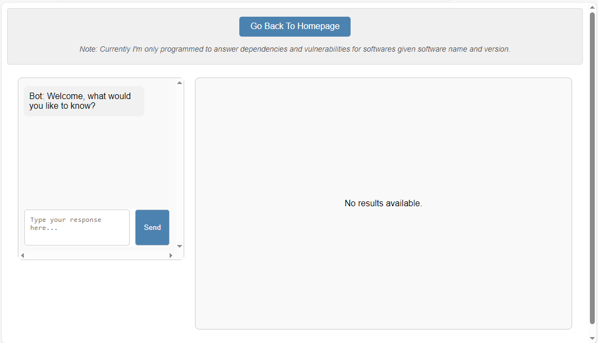
High-Level Architecture
User Interaction:
Natural language input via chatbot interface
Intent Detection:
identify user intent and extract key entities.
SPARQL Query Generation:
Map intent to SPARQL query format.
RDF Parsing:
Execute query on RDF data using RDFLib.
Response Generation:
Return human-readable results to user.

Slide 4
Flow Diagram
TO BE INSERTED ONCE MODIFIED

Slide 5
NLP Integration
Functionalities
Advantages
Chatbot:
Custom-built using React DOM
Handles user input and output.
LLMs :
Detects user intent and entities from natural language.
Converts input into structured SPARQL queries.
Hugggingface Interface to chain LLMs
Accessibility:
Allows non-technical users to interact with semantic data easily.
Efficiency:
Automates complex query creation.
Simplicity:
Leverages LLMs to perform various tasks including typo corrections and other minor fixes which would otherwise require more complex programming efforts

Slide 6
NLP Integration Challenges/Limitations and Work around
Lower level LLMs
Gpt-2 or similar
Available free of cost
Have limited capacity for complex language parsing
Current Application Built & Testing Limitations
Gpt-2 model trained sparsely for only two types of queries
Ask Bot for dependencies or vulnerabilities for a software
SPARQL queries are not generated by LLM
LLM selects the predefined query based on intent detection
SCREEN SHOT OF CHATBOT INTERACTION TO BE INSERTED HERE

Slide 7
NLP Integration Challenges/Limitations and Work around
Higher level LLMs
Gpt-3 or higher
Has advanced NLP capabilities and can generate complex queries correctly with provided ontology description and some training
This was verified using ChatGPT in lieu of the GPT-4 API integration (Cost constraints)
Current Application Built
Already has functions/Methods to utilize higher LLM built. Change LLM_type variable to “higher”.
Provided API Keys and some training, these functions can be used to automate generation of complex SPARQL queries from user input
SCREEN SHOT OF CHTGPT-4 interaction showing sparql query generated by GPT-4

Slide 8
Advanced Use Cases
IT Administrator
Developers
Upgrade software application version
Show the changes in CVEs with the proposed upgrades
Dashboard of current system Vulnerabilities and Dependencies
Integration with the SBOM tool
Helps track current vulnerabilities and Dependencies in an effective way
Developer team wants to build a new application XYZ using A,B,C software and H hardware. What are the dependencies and Vulnerabilities associated with it?
What alternative software to be used to minimize CVE of the proposed application

Slide 9

ROAD MAP AHEAD
This was just the first baby step
Promising and exciting prospect of integrating advanced LLM capabilities to automate data retrieval from RDF dataset
Future Work Proposed:
Advanced LLM Integration :
Train for various query types and more advanced queries
Visualization:
Leverage graph transformers for building interactive graphical visualization

